Slide 1
Insert, Update, Delete, RI, and Constraints
Module 2: 04

Slide 2
Objectives
Inserts
Deletes
Updates
Constraints and referential integrity
Transactions

Slide 3
Data Operations - The CRUD
C - Create (INSERT)
R - Read (SELECT)
U - Update (UPDATE)
D - Delete (DELETE)

Slide 4
INSERT
Adds a new row of data to a table
INSERT INTO table_name (column1, column2, ..., column_n) VALUES (value1, value2, ... value_n);
Can be shortened to insert every column:
INSERT INTO table_name VALUES (value1, value2, ... value_n);

Slide 5
UPDATE
Updates the value of columns on an existing row of data for the specific rows.
UPDATE table_name SET column = value WHERE column = value;
Can update multiple columns in a since update statement.
UPDATE table_name SET column1 = value1, column2 = value2 WHERE column = value;

Slide 6
DELETE
Deletes row(s) of data from a table.
DELETE FROM table_name WHERE column=value;

Slide 7
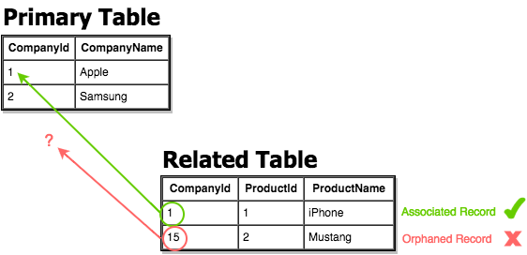
Referential Integrity
Referential Integrity is a property of the data stating whether or not references within it are valid. For example, to use a foreign key on a table, the value must exist on the primary table.

Slide 8
Constraints
A constraint on a table defines properties that the column data must comply with. It sets a rule that must be obeyed to maintain the integrity of the data.
NOT NULL | The column cannot contain a null value
UNIQUE | The column can only contain unique values
PRIMARY KEY | Enforces NOT NULL and UNIQUE. Allows Foreign Key relationships to be established.
FOREIGN KEY | Only allows values where the value exists on the related table. Does not allow the related value to be removed from the related table as long as the foreign key value is in use.
CHECK | Specifies a list of acceptable values that can be added into a column
DEFAULT | Provides a default value for a column, if no value is provided.

Slide 9
Transactions
A transaction is a single unit of work made up of multiple SQL statements that must all succeed or fail as one.
When a transaction is successful it is committed and the data is saved in the new state.
When a transaction fails it is rolled back and all the data is left in the original state.

Slide 10
The ACID Test
The ACID Test is used to determine whether a series of actions should be a transaction.
Atomicity (Atomic): Must the actions occur as all or none
Consistency (Consistent): Once the series of actions is complete is the data left in a consistent state, meaning that saved data cannot violate the integrity of the database so any rules that pass before the transaction still pass after the transaction.
Isolation: Does the final result of the transaction leave the data in the same state as they would have if executed serially. Other transactions don’t affect the outcome and must wait for this one to complete before they are applied.
Durability: Once the transaction has been committed, will it remain so even after an error, system crash, or power loss.

Slide 11
Transaction Syntax
START TRANSACTION
Do the UPDATE/INSERT/DELETE statements
COMMIT (ends the transaction and saves the changes)
OR
ROLLBACK (ends the transaction without saving the changes)
Transactions can be used to safely test a statement that changes the database during development/testing.

Slide 12
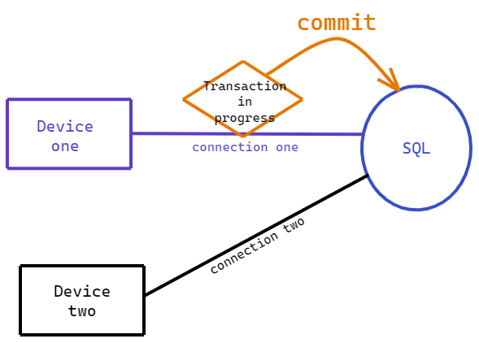
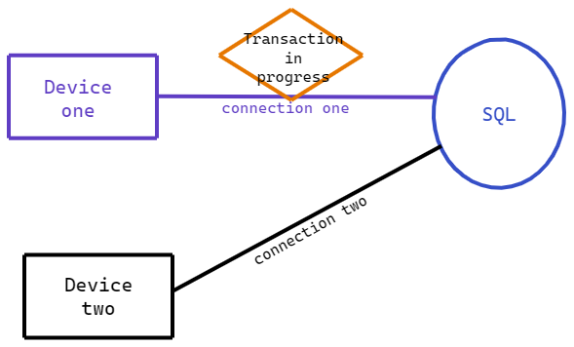
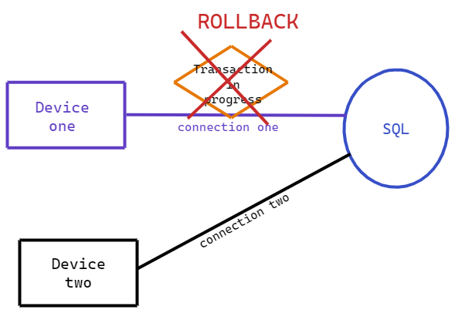
Transactions and Connections
Transactions happen on the connection. Each application has its own connection(s). The results of a transaction cannot be seen by other connections until it is committed.

